Slide 1
Angular 2
TypeScript Introduction
Notes:
Add instructor notes here.

Slide 2
TypeScript
TypeScript
ES6
ES5
classes
modules
types
annotations
ANGULAR 2 IS BUILT IN TYPESCRIPT
Notes:
TypeScript is a free and open source programming language developed and maintained by Microsoft.
TypeScript is a typed superset of JavaScript.
TypeScript is designed for development of large applications and compiles to JavaScript.
TypeScript offers classes, modules, and interfaces to help you build robust components.
TypeScript syntax includes several proposed features of ECMAScript 6 (ES6)
TypeScript aligns more closely with ES6 standards and some new features of its own.
TypeScript isn’t a completely new language, it’s a superset of ES6.
ES6 code is nothing but a compilable TypeScript code.
One of the main goals for the upcoming TypeScript 2.0 release is to fully support the ECMAScript 6 standard.
Add instructor notes here.

Slide 3
Why TypeScript
TypeScript can be used for cross browser development and is an open source project
TypeScript compiles code which has syntax similar to ES6 to simple JavaScript code which runs on any desktop browsers, mobiles, servers / runtimes, or in any other ES3-compatible environment
Using TypeScript developers can apply class-based approach, compile them down to JavaScript without waiting for the next version of JavaScript.
With TypeScript existing JavaScript code can be easily incorporated with popular JavaScript libraries like jQuery, Backbone, Angular and so on.
Enable scalable application development with optional Static types, classes and modules. Static types completely disappear at runtime.
TypeScript converts JavaScript Programming from loosely typed to strongly typed.
Notes:
Add instructor notes here.

Slide 4
Getting Started with TypeScript
Visual Studio includes TypeScript in the box, starting with Visual Studio 2013 Update 2 and in Visual Studio 2015.
Text editors like WebStorm, Atom, SublimeText, Eclipse and Brackets(freeware) can be used.
TypeScript compiler can be installed for Node Environment by installing it as a node package.
npm install -g typescript (installing typescript as a global module)
tsc <filename.ts> (To compile TypeScript from command line).
In the webpages, we need to refer JavaScript code file (*.js) and not the TypeScript code file (*.ts)
Microsoft provides an online editor, where we can compile TypeScript Code to Native JavaScript.
Link : http://www.typescriptlang.org/Playground
Notes:
ES6 output mode
In previous TypeScript releases, ‘‐‐target' command line option that allows us to choose between ES3 and ES5 output modes in TypeScript 1.4 a new ‘ES6’ option to the targets command line option:
> tsc ‐‐target ES6 myfile.ts
This option will be required for ES6 features that cannot be output to ES3 or ES5, just as ES5‐only features, such as getters and setters, have required the ES5 target option.
Add instructor notes here.

Slide 5
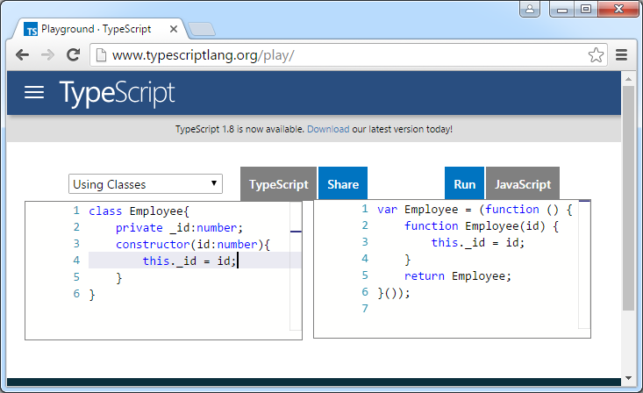
TypeScript Playground
Notes:
Add instructor notes here.

Slide 6
Basic Types
TypeScript supports the following Basic Types
boolean
array
number
string
any
enum
void
enum
Notes:
/*number type*/
var age:number = 33;
/*string type*/
var name:string = "Karthik";
/*boolean type*/
var maritalStatus:boolean = true;
/*number Array*/
var numbers:number[] =[1,2,3];
/*number Array - Generic*/
var numberList:Array<number> =[1,2,3];
/*Enum*/
enum Directions {NORTH, EAST, WEST, SOUTH};
var myDirection:Directions = Directions.EAST;
/*any type*/
var test:any = "Karthik"
/*void*/
function nothing(): void {
alert("Function doesn't return a value");
}
Add instructor notes here.

Slide 7
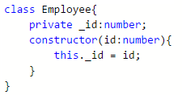
Classes in TypeScript
Traditional JavaScript focuses on functions and prototype-based inheritance, it is very difficult to built application using object-oriented approach.
Starting with ECMAScript 6 (the next version of JavaScript), JavaScript programmers can build their applications using this object-oriented class-based approach.
TypeScript supports public , private and protected access modifiers. Members of a class are public by default.
Notes:
Code Snippet
class Foo {
name: string;
constructor(name: string) {
this.name = name;
}
greet() {
return "Hello, " + this.name;
}
}
var fooObj = new Foo("Karthik");
fooObj.greet();
Add instructor notes here.

Slide 8
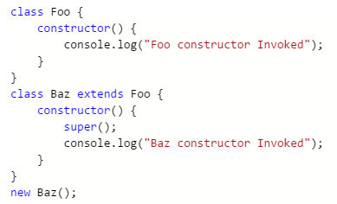
Inheritance
TypeScript allows us to extend existing classes to create new ones using inheritance.
'extends' keyword is used to create a subclass.
'super()' method is used to call the base constructor inside the sub class constructor.
Notes:
Code Snippet
class BankAccount {
protected accountNumber:number;
protected bankName:string;
constructor(accountNumber: number,bankName:string) {
this.accountNumber = accountNumber;
this.bankName = bankName;
}
deposit() {
return "Cash Deposited in A/C No : " + this.accountNumber;
}
withdraw() {
return "Cash Withdraw from A/C No : " + this.accountNumber;
}
}
class SavingsAccount extends BankAccount{
private _accountType: string;
constructor(accountType:string, accountNumber: number,bankName:string) {
super(accountNumber,bankName);
this._accountType = accountType;
}
printInfo() {
return "A/C No : " + this.accountNumber +" Bank Name : "+this.bankName+" Saving Type : "+this._accountType;
}
}
Add instructor notes here.

Slide 9
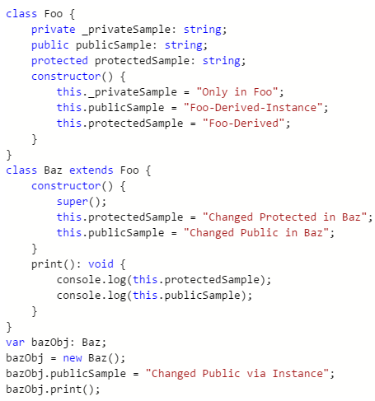
Inheritance
Notes:
Inheritance using JavaScript
Add instructor notes here.

Slide 10
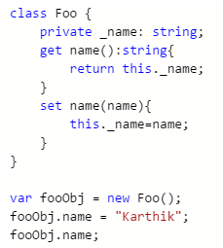
Accessors
TypeScript supports getters/setters as a way of intercepting accesses to a member of an object.
It gives way of having finer-grained control over how a member is accessed on each object.
Notes:
Creating Properties in JavaScript
Add instructor notes here.

Slide 11
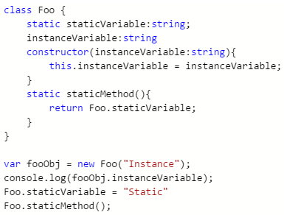
Static Property
In TypeScript we can also create static members of a class, those that are visible on the class itself rather than on the instances.
Notes:
Add instructor notes here.

Slide 12
Optional, Default & Rest Parameters
In JavaScript, every parameter is considered optional, we can get this functionality in TypeScript by using the '?' beside parameters we want optional. Optional parameters must follow required parameters.
function test(firstName:string, lastName?:string){ }
In TypeScript, we can also set up a value that an optional parameter will have if the user does not provide one. These are called default parameters.
function test(firstName:string, lastName = "Gupta"){ }
To pass multiple parameters as a group or when we don't know how many parameters a function take we can use parameter followed by (…)
function test(firstName:string,…others:string[ ]){ }.
Notes:
Code Snippet
function buildName(firstName: string, middleName?: string, lastName = "M", ...others:string[]) {
if (middleName !== undefined)
console.log("%s %s %s", firstName, middleName, lastName);
else
console.log("%s %s", firstName, lastName);
if(others.length > 0){
others.forEach(function(item){
console.log(item);
});
}
}
buildName("Karthik");
buildName("Ashik", "Mohammed", "Ibrahim");
buildName("Ashik", "Mohammed", "Ibrahim","Test1","Test2");
Add instructor notes here.

Slide 13
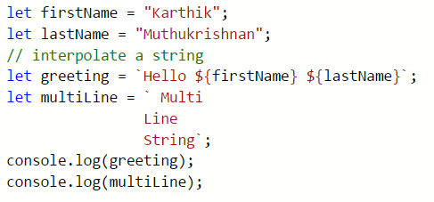
Template Strings
In ES6 new template strings were introduced.
The two salient features of template strings are
Variables within strings (without being forced to concatenate with +)
Multi-line strings (using backticks ` )
Notes:
Code Snippet
let firstName = "Karthik";
let lastName = "Muthukrishnan";
let greeting = `Hello ${firstName} ${lastName}`;
le multiLine = ` Multi
Line
String`;
console.log(greeting);
console.log(multiLine);
Add instructor notes here.

Slide 14
Arrow Functions
Arrow function expressions are a compact form of function expressions that have a scope of this.
We can define an arrow function expression by omitting the function keyword and using the lambda syntax =>
Arrow functions allows us to write more complex function expressions as callbacks and inline functions more easily.
Notes:
/*Without arrow function*/
class Test{
private _name = "Karthik";
printName() {
setTimeout((function () {
//this refers window Object not the Test Object
alert(this._name);
}),1000);
}
}
var testObj: Test = new Test();
testObj.printName();
/*Using arrow function*/
class Test{
private _name = "Shilpa";
printName() {
setTimeout(() => {
alert(this._name);
},3000);
}
}
var testObj: Test = new Test();
testObj.printName();
Add instructor notes here.

Slide 15
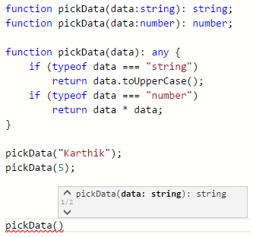
Function Overload
JavaScript is inherently a very dynamic language.
JavaScript functions can be overloaded and return different types of objects based on the arguments passed in.
Notes:
Add instructor notes here.

Slide 16
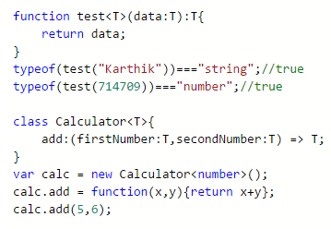
Generics
Generics plays a vital role in creating reusable components.
Component can be created to work over a variety of types rather than a single one.
Notes:
Add instructor notes here.

Slide 17
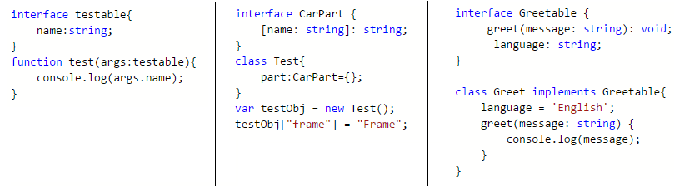
Interfaces
Interfaces plays many roles in TypeScript code.
Describing an Object : If function take lot of members but you're likely to pass a few of those, we can describe an object using interface with optional parameters
Describing an Indexable Object : Using TypeScript interfaces we can represent the expected type of an indexing operation.
Ensuring Class Instance Shape: Interface can be used in the same way which we use in traditional OOP languages like C# and JAVA.
Notes:
Code Snippet
interface FooInterface {
id: number;
name: string;
employeeType?: string;
test?(info:string):string;
}
function printFooInfo(employeeObj: FooInterface) {
if(employeeObj.employeeType)
console.log(“employeeObj.id,employeeObj.name,employeeObj.employeeType);
else
console.log("%d %s",employeeObj.id,employeeObj.name);
}
var obj = {
id:714709,
name:'Karthik',
employeeType:'Permanent',
test:function(str:string){
return "";
}
};
printFooInfo(obj);
Add instructor notes here.

Slide 18
Modules
A module is the overall container which is used to structure and organize code.
It avoids collision of the methods/variables with other global APIs.
TypeScript support modules to organize the code.
'export' keyword is used before the classes/ inner module to make it visible outside the module.
We can refer the multi file internal module using the following line and compile multiple internal file into a single JS file using typescript compiler
/// <reference path="<typescriptfilename>" />
External modules can be imported using 'import' keyword
import module1 = require('./Module1');
Notes:
To Compile the Internal Module
tsc --out Module.js Test-Module-Internal.ts
To Compile the External Module
tsc --module commonjs Test-Module-External.ts
Add instructor notes here.

Slide 19
Declaration file (.d.ts)
Documentation helps developers to understand the implementation details of JavaScript libraries.
It is very much important to describe the shape of an external JavaScript library or new host API, so that it will make developer's life easier rather reading and understanding the JS code.
Using a declaration file (.d.ts) in TypeScript, we can describe the shape and provide the documentation for the JavaScript library.
To generate declaration file use the command : tsc --declaration <tsfilename>
definitelytyped.org is the repository for high quality TypeScript type definitions for popular JavaScript Libraries like jQuery, Angular, Backbone etc.
Notes:
Add instructor notes here.

Slide 20
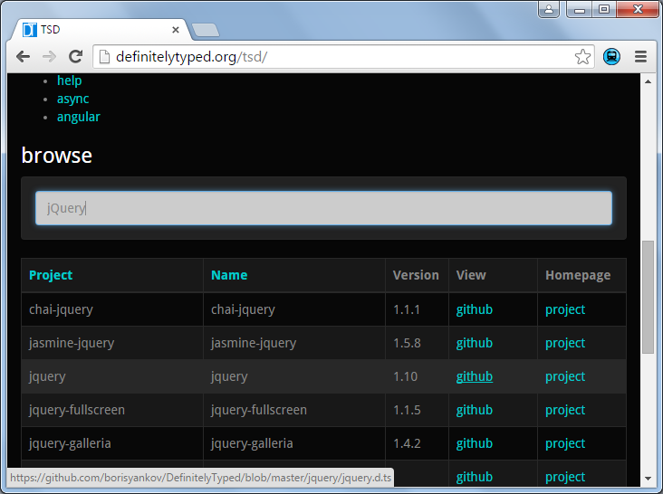
definitelytyped.org
Notes:
Add instructor notes here.

Slide 21
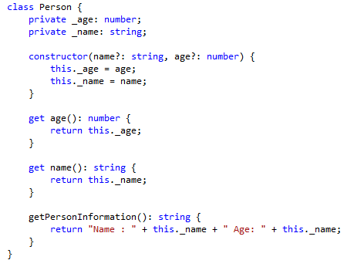
Person.ts
Notes:
Add instructor notes here.

Slide 22
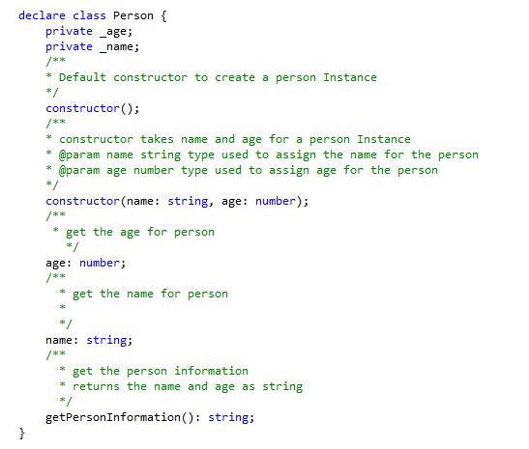
Person.d.ts
Notes:
Add instructor notes here.

Slide 23
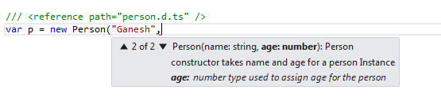
app.ts
Notes:
Add instructor notes here.

Slide 24
Summary
TypeScript is an open source project maintained by Microsoft.
TypeScript generates plain JavaScript code which can be used with any browser.
TypeScript offers many features of object oriented programming languages such as classes, interfaces, inheritance, overloading and modules, some of which are proposed features of ECMA Script 6.
TypeScript is a promising language that can certainly help in writing neat code and organize JavaScript code making it more maintainable and extensible.
Angular 2 is built in typescript
Notes:
Add instructor notes here.

